Slide 1
Textbook : Operating Systems Concepts by Silberschatz
Operating SYSTEMS

Slide 2
CS 206 Operating systems
Course Outcomes: After the completion of the course the student will be able to
CO1: Explain the relevance, structure and functions of Operating Systems in computing
devices.
CO2: Illustrate the concepts of process management and process scheduling mechanisms
employed in Operating Systems.
CO3: Explain process synchronization in Operating Systems and illustrate process
synchronization mechanisms using Mutex Locks, Semaphores and Monitors
CO4:Explain any one method for detection, prevention, avoidance and recovery for
managing deadlocks in Operating Systems.
CO5:Explain the memory management algorithms in Operating Systems.
CO6:Explain the security aspects and algorithms for file and storage management in
Operating Systems.

Slide 3
INTRODUCTION
Every computer is composed of two basic components:
Hardware
Software
Hardware: Computer hardware includes the physical parts of a computer, such as central processing unit (CPU), monitor, mouse, keyboard, computer data storage, graphics card, sound card, speakers and motherboard.
Software: is a set of programs which enables the user to solve problems using computer

Slide 4
SOFTWARE
The Software is set of instructions or programs written to carry out certain task on digital computers.
Generally, there are two main classifications of software
System software
Application software

Slide 5
SYSTEM SOFTWARE
System software: is a collection of system programs which aids the effective execution of general users computational requirements on a computer system.
Eg: OS, linker , loader
Application software: Application software or programs are used to solve some particular application problems.
E.g.: word processor ,spreadsheet, an accounting application etc.

Slide 6
COMPONENTS OF COMPUTER SYSTEMS
Computer system can be divided into four components:
Hardware – provides basic computing resources
- CPU, memory, I/O devices
Operating system
- Controls and coordinates use of hardware among various applications and users
System and Application programs – define the ways in which the system resources are used to solve the computing problems of the users
- Word processors, compilers, web browsers, database systems, video games
Users
- People, machines, other computers

Slide 7
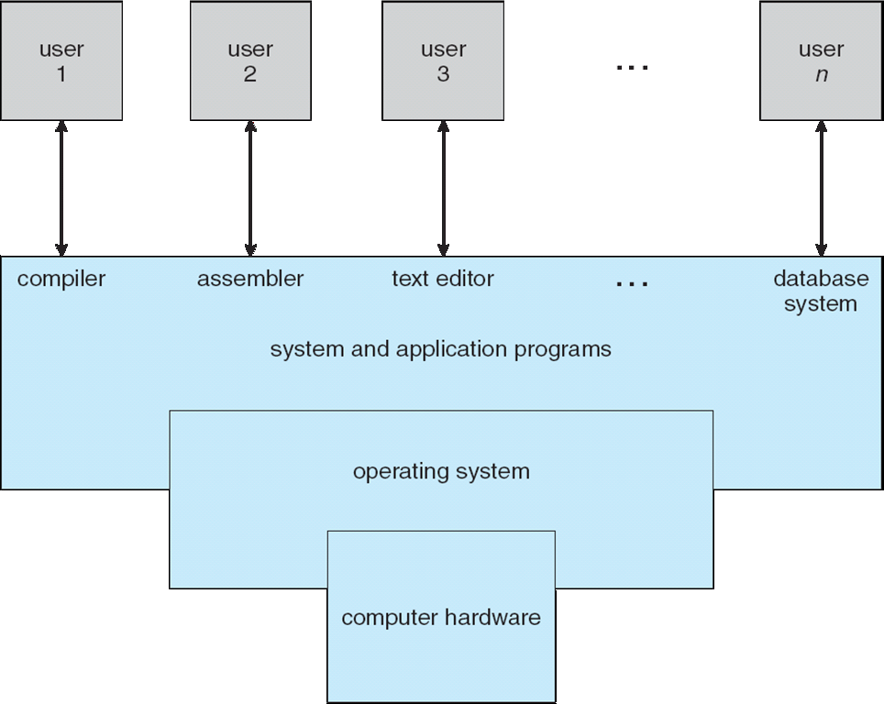
Abstract view of the components of a computer system
Operating system concepts-9th edition
Silberschatz,galvin,Gagne @2013

Slide 8
OPERATING SYSTEM - A system software
OS takes care of effective and efficient utilization of hardware and software components of the computer system
Act as an interface between the users and the system.
Manages computer hardware and software resources
Provides common services for computer programs.
Provides an interface which is more user-friendly than the underlying hardware.
Acts as an extended machine
The operating system masks or hides the details of the hardware from the programmers and general users and provides a convenient interface for using the system. OS is the program that hides the truth about the hardware from the user and presents a nice simple view of named files that can be read and written

Slide 9
OPERATING SYSTEM
An operating system (OS) is basically a collection of software that manages computer hardware resources and provides common services for computer programs. The operating system is a crucial component of the system software in a computer system.
It also provides a basis for application programs and acts as an intermediary between the computer user and the computer hardware.
The fundamental goal of computer systems is to execute user programs and to make solving user problems easier.
The common functions of controlling and allocating resources for user programs are then brought together into one piece of software: the operating system.
Most commonly used Operating systems for personal computers are
Microsoft Windows, macOS,Linux

Slide 10
OPERATING SYSTEM
Basic Functions of Operating System:
The various functions of operating system are as follows:
1. Process Management:
A program does nothing unless their instructions are executed by a CPU.A process is a program in execution. A time shared user program such as a complier is a process. A word processing program being run by an individual user on a pc is a process.
A system task such as sending output to a printer is also a process. A process needs certain resources including CPU time, memory files & I/O devices to accomplish its task.
These resources are either given to the process when it is created or allocated to it while it is running.

Slide 11
OPERATING SYSTEM
The OS is responsible for the following activities of process management.
Creating & deleting both user & system processes.
Suspending & resuming processes.
Providing mechanism for process synchronization.
Providing mechanism for process communication.
Providing mechanism for deadlock handling.

Slide 12
OPERATING SYSTEM
2. Main Memory Management:
The OS is responsible for the following activities in connection with memory management.
Keeping track of which parts of memory are currently being used & by whom.
Deciding which processes are to be loaded into memory when memory space becomes available.
Allocating &deallocating memory space as needed.

Slide 13
OPERATING SYSTEM
3. File Management:
For convenient use of computer system the OS provides a uniform logical view of information storage. The OS abstracts from the physical properties of its storage devices to define a logical storage unit the file. A file is collection of related information defined by its creator. The OS is responsible for the following activities of file management.
Creating & deleting files.
Creating & deleting directories.
Supporting primitives for manipulating files & directories.
Mapping files into secondary storage.
Backing up files on non-volatile media.

Slide 14
Operating system
4. I/O System Management:
OS keeps track of the devices,
Decides who should get how much time and when the devices
Allocate the device and initiate the I/O operations
Reclaim the resource(device)
5. Secondary Storage Management:
Most modern computer systems are disks as the storage medium to store data & program. The operating system is responsible for the following activities of disk management.
Free space management.
Storage allocation.
Disk scheduling
Because secondary storage is used frequently it must be used efficiently.

Slide 15
OPERATING SYSTEM
Protection or security:
If a computer system has multi users & allow the concurrent execution of multiple processes then the various processes must be protected from one another‘s activities.
For that purpose, mechanisms ensure that files, memory segments, CPU & other resources can be operated on by only those processes that have gained proper authorization from the OS.

